Slide 1
Basic Statistics

Slide 2

https://www.pinterest.com/pin/250723904226784778/

Slide 3
What is Statistics?
Statistics is the science of
Collecting
Organizing
Summarizing
Analyzing and
Interpreting data
The goal of statistics is to:
Infer facts
Make predictions about future
Help make better decisions

Slide 4
Basic Definitions

Slide 5
Variables
Properties or characteristics of some event, object, or person that can take different values
An attribute that describes a person, place, thing or ides
Examples:
Height of a person
Hair color of a person
Inflation percentage in a country
Number of votes scored by a candidate in an election
Number of persons in a household
Notes:
Human hair colour: Black, Brown, Blonde, White, Red

Slide 6
Types of Variables
Variables
Quantitative
Qualitative
Discrete
Continuous
Notes:
Use titanic data to explain the types of variables

Slide 7
Dependent & Independent Variables
In statistics, the dependent variable is the event studied and expected to change whenever the independent variable is changed or altered
E.g. Final marks obtained by students vs. time spent by the students
The variable final mark is dependent on the independent variable time spent
Independent variable represent the input or causes and is also known as predictor variable
Dependent variable represent the output or effect and is also known as output variable

Slide 8
Quantitative & Qualitative Variables
Quantitative variables take on values that are numeric for which arithmetic operations make sense
E.g. Height of a person, GDP of a country etc.
Qualitative variables take on values that are names or labels
E.g. Hair color, breed of dog etc.
Qualitative variables are numeric and hence arithmetic operations on Qualitative variables do not make sense
Notes:
Differentiate height of a person vs. hair colour of a person

Slide 9
Discrete & Continuous Variables
Discrete variables can take only certain values
E.g. Number of persons in a household, outcome of rolling a six sided die
Continuous variables can take any value between its maximum and minimum value
E.g. Time taken by students to complete a 3 hour test, Height of students in a class
Notes:
A household can’t have 5.5 members
Height can be any value between the shortest student and the tallest student
Practicality stops us from making any variable truly continuous. (time can be 1.2s or 1.233s or 1.2334s etc. Here we are limited by our ability to measure. If we are able to measure only milliseconds, the variable becomes discrete milliseconds and not truly a continuous variable)

Slide 10
Classify the variables
Breed of dog
Blood sugar level of a person
Final result in a examination
Number of matches played by a player
Batting average of a player
Favourite colour
State which you belong to
Marks scored in a subject
Average marks in all subjects
Notes:
Breed of dog - Qualitative
Blood sugar level of a person _ Quantitative Continuous
Final result in a examination - Qualitative (Pass or Fail)
Number of matches played by a player - Quantitative Discrete
Batting average of a player - Quantitative Continuous
Favourite colour - Qualitative
State which you belong to - Qualitative
Marks scored in a subject - Quantitative Discrete
Average marks in all subjects - Quantitative Continuous

Slide 11
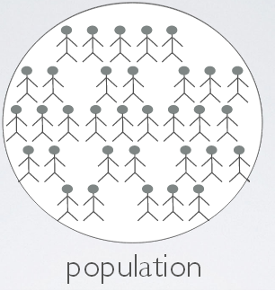
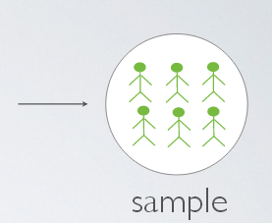
Population & Sample
http://www.bindichen.co.uk/post/Notes/data-analysis-and-statistical-inference/experimental-design-and-random-sample-assignment.html

Slide 12
Population & Sample (contd.)
Population is the whole set of values or individuals you are interested in
The number of items or elements in a population is called the population size, denoted by N
Sample is a subset of the population
Sample size (number of observations in the sample) is denoted by n
Randomization schemes help to build samples that are truly representative of the population
Notes:
Suppose we are interested in the height of all 10th standard students in India. Here all students who are in 10th standard represent the population. Since measuring every student’s height is very difficult we can select a sample of 10000 students and find their average. But to make sure that the sample is a true representative of the population, we need to make sure that the sample of 10000 students are drawn randomly from all regions of the country

Slide 13
Scales of Measurement
Measurement scales are used to categorize and/or quantify variables
Four different scales are commonly used in statistics:
Nominal
Ordinal
Interval
Ratio

Slide 14
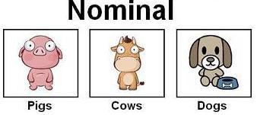
Nominal Scale
www.suggestkeyword.com

Slide 15
Nominal Scale (contd.)
Most basic level of measurement
In Nominal Scale, data is neither measured nor ordered
Subjects are merely allocated to distinct categories
Also known as categorical or qualitative
Examples:
Sex
Color preference
Religion
Values can be stored as text or a numerical code
However numbers do not imply order

Slide 16
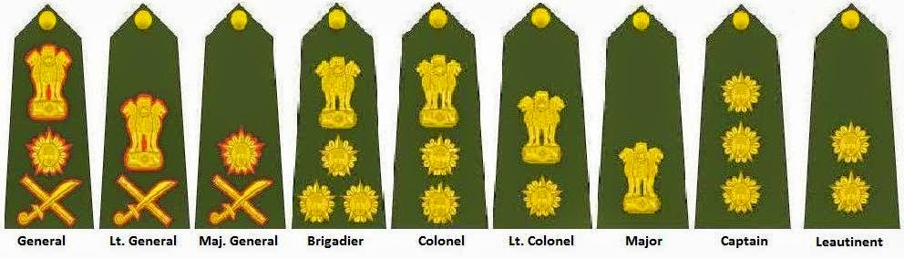
Ordinal Scale
http://www.ssbinterviewtips.in/2013/02/rank-structure-and-pay-scales-of-army.html

Slide 17
Ordinal Scale (contd.)
Next level of measurement is Ordinal
Data is ordered
But difference between two levels may not be the same as the difference between another two levels
Comparison is however possible
Examples:
Military Rank
Consumer Satisfaction Ratings
Rankings in a class
Notes:
For example, lets take the final positions in a race. The order is meaningful. The person who finished first covered the distance in the shortest time, the second in the next shortest time and so on.. But the difference between the time of first and the second may not be the same difference between 2 and 3 or 4 and 5. Hence the values are not equally placed

Slide 18
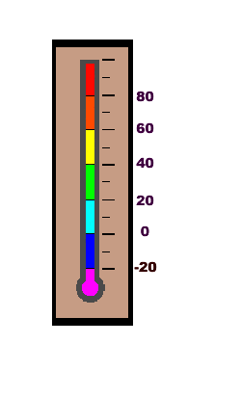
Interval Scale
http://www.wpclipart.com/weather/weather_instruments/thermometer/thermometer.png.html

Slide 19
Interval Scale (contd.)
Order is meaningful
Intervals are equal
Things that can be measured are expressed in interval scale
But data has no zero point and hence ratio is of no real meaning
Examples:
Time of a day
Temperature in Celsius
Notes:
Difference between 30 degree Celsius and 40 degree Celsius is the same as the difference between 40 degree Celsius and 50 degree Celsius. There is no true zero here. Zero means absence of heat. So we can’t take ratios of temperatures. Ratio of 20 to 40 degree Celsius is not the same as 50 to 100 degree Celsius. We can’t say 100 degrees is twice as hot as 50 degrees

Slide 20
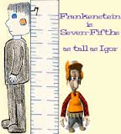
Ratio Scale
http://www.etc.edu.cn/eet/articles/measurescales/start.htm

Slide 21
Ratio Scale (contd.)
Highest and most informative scale
Has the qualities of nominal, ordinal and interval scales with the addition of an absolute zero point
Examples:
Years of experience
Amount of money
Number of children in a household
Notes:
Absolute zero: 0 money means no money

Slide 22
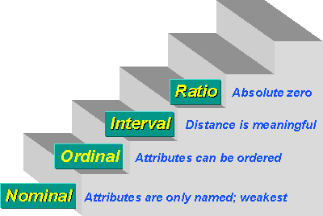
Scales of Measurement (contd.)
http://www.socialresearchmethods.net/kb/measlevl.php

Slide 23
Scales of Measurement (contd.)
Let us consider a set of candidates taking an exam. Identify which scale of measurement to be used to measure the following variables:
Sex of the candidate
State which the candidate is from
Optional subjects chosen by the candidate
Marks obtained by the candidate
BMI Classification of a candidate (Underweight, Ideal, Overweight, Obese)
Final grade obtained by the candidate
Confidence level of candidate before taking exam on a scale of 1 to 10
Notes:
Sex of the candidate - Nominal
State which the candidate is from - Nominal
Optional subjects chosen by the candidate - Nominal
Marks obtained by the candidate – Ratio
BMI Classification of a candidate - Ordinal
Final grade obtained by the candidate - Ordinal
Confidence level of candidate before taking exam on a scale of 1 to 10 - Interval

Slide 24
Summarizing Data
Central Tendency

Slide 25

Arithmetic Mean
Sum of collection of numbers divided by the number of numbers
Commonly known as average
Measure of central tendency
Commonly denoted by the symbol x̅
Arithmetic Mean = (sum of observations) / (No. of observations)
Notes:
Other things to do self-learning: Geometric Mean, Harmonic Mean

Slide 26
Median
The number separating the higher half of the data sample from the lower half
In other words it is the middle number between the smallest number and the largest number
Can be found by arranging the observations from lowest value to the highest value and picking the middle one
When the number of observations is odd: Median is (n+1)/2th observation
When the number of observations is even: Median is mean of n/2th and (n/2)+1th observation
Notes:
Give the example of salary

Slide 27
Trimmed Mean
Consider the following set of numbers:
34, 46, 38, 33, 41, 37, 43, 35, 42, 38
Find the mean and median
Mean is 38.7 and Median is 38
Now consider this new set of numbers:
34, 46, 38, 33, 99, 37, 43, 35, 42, 38
Find the mean and median
Mean is 44.5 and Median is 38

Slide 28
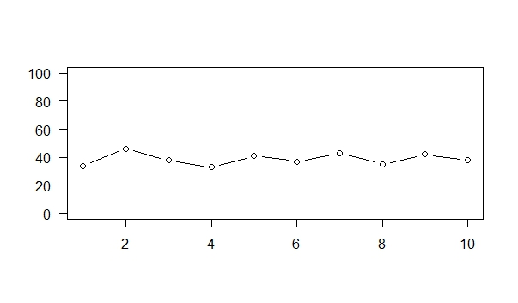
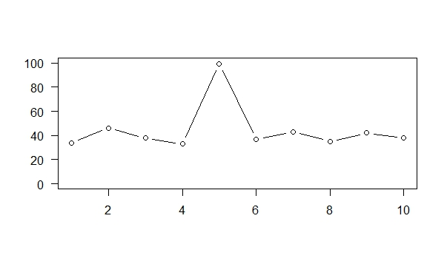
Trimmed Mean (contd.)
First Set
Second Set
Notes:
The outlier can be due to error in measurement or data entry error or any other type of error. For e.g. in a dataset, age of say 245 is definitely an error and we need to handle it before we do further analysis. If outliers aren’t an error, then they be very interesting to study

Slide 29
Trimmed Mean (contd.)
Consider the following set of numbers:
34, 46, 38, 33, 41, 37, 43, 35, 42, 38
Find the mean and median
Mean is 38.7 and Median is 38
Now consider this new set of numbers:
34, 46, 38, 33, 99, 37, 43, 35, 42, 38
Find the mean and median
Mean is 44.5 and Median is 38
The difference is because there is an outlier in the data ‘99’ which is vastly different from the rest of the data
Outlier influences the mean

Slide 30
Trimmed Mean (contd.)
Trimmed Mean is normal Mean except that a certain percentage of the extremes are omitted while calculating the mean
This effectively removes the outliers from the observations
The 10% trimmed mean of the observation is 39.125
The Trimmed Mean 39.125 is more closer to the Median 38 than the true Mean 44.5

Slide 31
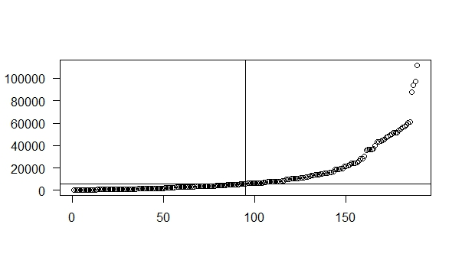
Quartile
Median divides the data into two equal halves

Slide 32
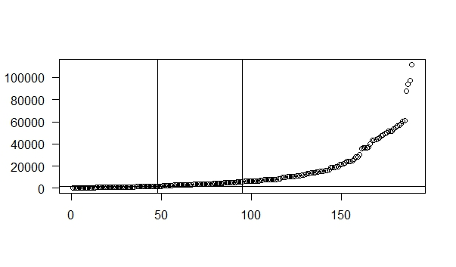
Quartile (contd.)
Lets consider the lower half of the data
The value 1781 is called the 1st Quartile
1/4th of the observations are below 1781
Notes:
Centre of the first half is 48

Slide 33
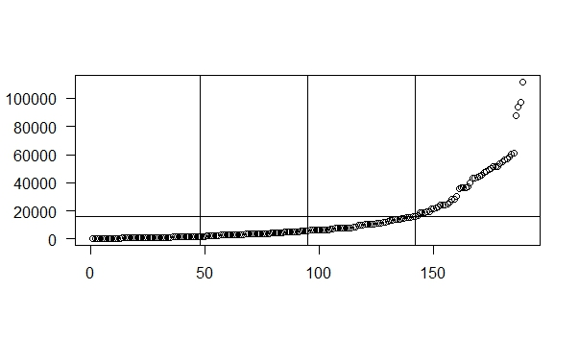
Quartile (contd.)
The value 16199 is called the 3rd Quartile
3/4th of the observations are below 16199
Median is the 2nd Quartile
Notes:
Centre of the second half is 142

Slide 34
Mode
Mode is the value that appears most often in a set of data
E.g. mode of 1,1,2,4,5,4,6,3,7,1 is 1 since 1 is appearing three times
A data may have more than one mode
E.g. the dataset 1,1,3,1,4,5,5,6,5 has two modes 1 and 5
A data may not have a mode
E.g. the dataset 1,2,3,4,5 doesn’t have a mode since all the numbers appear only once
There is no standard library function to find mode in R
Notes:
Write a function to find Mode

Slide 35
Mode (contd.)
Write a function to calculate mode
Steps:
Select all the unique values of the object
Count the number of times each unique value appears in the object
Store the count values in a vector
Find out the maximum value of the count using ‘which’ function
Find out the unique values which correspond to the maximum value
Use ‘if’ condition to return an error message if all unique values have same count
Notes:
Write a function to find Mode

Slide 36
Summarizing Data
Spread of the data
Notes:
Now we have seen ways of measuring what is the centre of data. Now we are going to see how far the observations are spread out (dispersion) or away from the mean

Slide 37
Range
Range is the difference between the lowest and the highest values
In {4, 5, 9, 3, 8} the lowest value is 3, and the highest is 9, so the range is 9 − 3 = 6
Most useful in representing the dispersion of small data sets
Notes:
Range command in R gives max and min values. We need to use diff command to get the range as a difference

Slide 38
Inter Quartile Range
Difference between the 1st quartile and the 3rd quartile
Middle half of the data fits into the Inter Quartile Range (IQR)
Also known as mid-spread or middle fifty
Notes:
Middle half of the data can be fit into the Inter Quartile Range

Slide 39
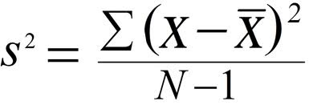
Variance & Standard Deviation
Measures how spread out our data is with reference to the mean
Variance is always positive
Small variance means data are close to each other
Large variance means data are spread out widely
Standard deviation is the square root of variance
Notes:
We can add all the individual deviations from the mean
But this will always lead to 0 since positive deviations will cancel out negative deviations
We can also add absolute value of the deviations
Adding the squares of all the deviations from all the means is the best way
why we divide by n-1 instead of n in standard deviation?
Dividing by n-1 is the best thing to do as it gives an unbiased estimate of population variance
Intuitively, the first value doesn't tell anything about the spread and it is only the remaining n-1 values which say something about the spread
If n is very large, it doesn't matter if you divide by n or n-1

Slide 40
Variance & Standard Deviation (contd.)
The value in the denominator of the formula is called as the Degrees of Freedom
Degrees of Freedom is the number of values in the final calculation of a statistic that are free to vary
Standard deviation is usually denoted by the symbol sigma σ or S²
Empirical Rule:
~ 68% of data lies within the range (mean – 1σ) and (mean + 1 σ)
~ 95% of data lies within the range (mean – 2σ) and (mean + 2σ)
~ 99.7% of data lies within the range (mean – 3σ) and (mean + 3σ)
Notes:
Now suppose you are asked to choose a pair of numbers whose sum is 7. It is readily apparent that only one number can be chosen freely, the second being fixed as soon as the first is chosen. Although there are two variables in the situation, there is only one variable which is free to vary.
In the case of Variance, we are given the mean of the N observations. Since we know the mean, if we know N-1 observations, we can calculate the Nth observation. So, there is only N-1 degrees of freedom
Empirical Rule: So if your quality percentage is 99.7 you are at 3 sigma level
For 6 sigma level your quality percentage should be 99.9999998

Slide 41
Data Graphs

Slide 42
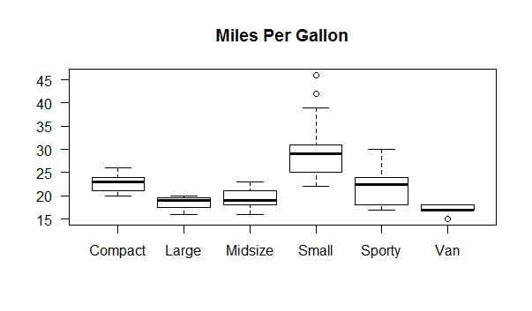
Box Plot

Slide 43
Box Plot (contd.)
Graphically summarize numerical variables
Central line is the median
The lower end of the box is the 25th percentile
The upper end of the box is the 50th percentile
Inter Quartile Range (IQR) is the difference between the 25th and 50th percentile
The whiskers are the lower inner fence and the upper inner fence
Lower inner fence = 1st Quartile – 1.5 * IQR
Upper inner fence = 3rd Quartile + 1.5 * IQR
Outliers are shown outside the whiskers
Summary command in R will give you all the values needed to create a box plot

Slide 44
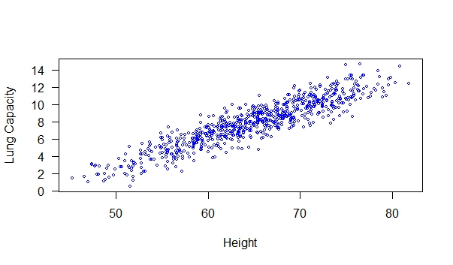
Scatter Plot

Slide 45
Scatter Plot (contd.)
Displays two variables for a set of data in x and y axes
It shows the relationship between two variables i.e. how much one variable is affected by the other
The relationship between the two variables is called their correlation
Notes:
Correlation will be covered in detail later

Slide 46
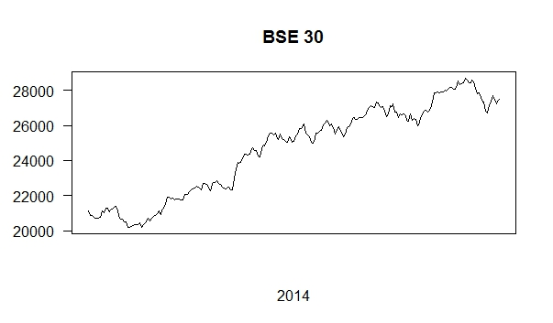
Line Graph

Slide 47
Line Graph (contd.)
Displays information as a series of data points connected by straight line segments
Useful in displaying data or information that changes continuously over time
Also known as Line Chart

Slide 48
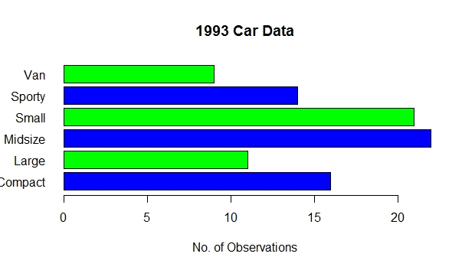
Bar Graph

Slide 49
Bar Graph (contd.)
Visual display of frequency or relative frequency (%) for each category of a categorical variable
Also known as ‘Bar Chart’ or ‘Column Bar Chart’
To construct a Bar Graph:
Compute frequency for each category
Plot frequency or relative frequency of each category as a bar
Height of each bar should correspond to the frequency of each category
Notes:
Presents grouped data with rectangular bars with lengths proportional to the values they represent

Slide 50
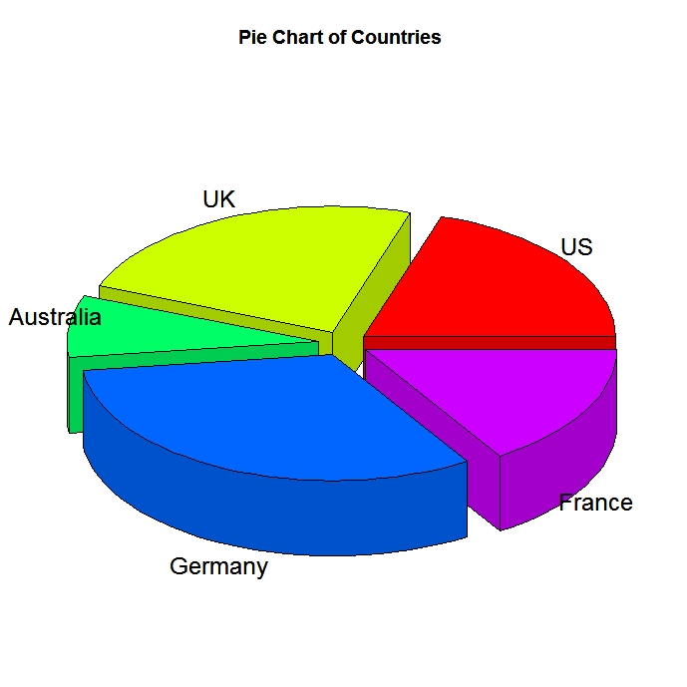
Pie Chart

Slide 51
Pie Chart (contd.)
Circular graphic divided into slices
The size of each slice (or the angle or length of the arc) is proportional to the quantity it represents
Pie Chart is widely criticized by statisticians in recent times because they are difficult to interpret

Slide 52
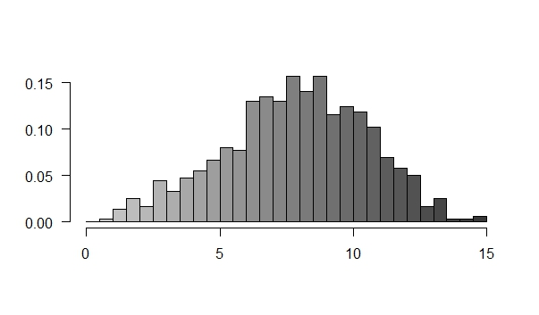
Histogram

Slide 53
Histogram (contd.)
Graphical representation of the distribution of numerical data
Shows how often each different value in a set of data occurs
To construct a Histogram:
Group numeric data into different bins of equal width
Place the bins on the horizontal axis
Place the frequencies (no. of occurrences) of each bin in the vertical axis using a bar extending across each bin
Notes:
Difference between bar charts and histograms: Bar charts are generally used to depict Categorical variables while histograms are used for quantitative variables. Bars are shown separately in Bar Chart since adjacent bars don’t have any relation. Whereas in histograms, bars are continuous without any gap (since they follow numerical order)

Slide 54
Histogram (contd.)
We can get a lot of information about the data using a histogram
The peak of the distribution is the mode of the data
A histogram can be unimodal (single peak), bimodal (two peaks) or multimodal (multiple peaks) or uniform (no prominent peaks)

Slide 55
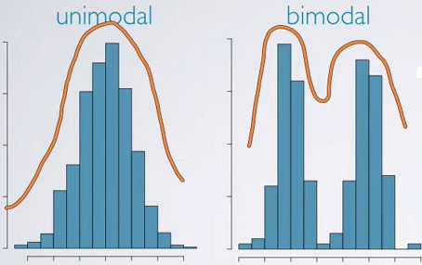
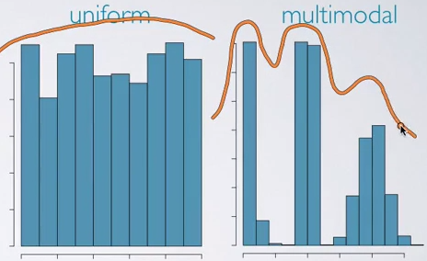
Histogram (contd.)
http://www.bindichen.co.uk/post/Notes/data-analysis-and-statistical-inference/visualizing-numerical-data.html

Slide 56
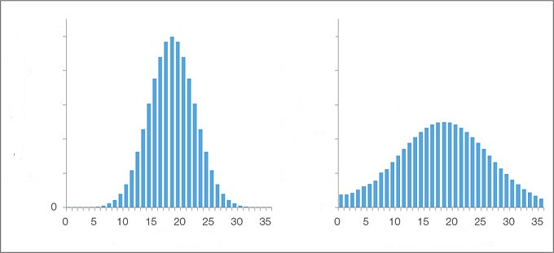
Histogram (contd.)
Histogram also gives us an idea about the extent of spread of data
Notes:
If the data is less spread out, variance and standard deviation will be less. But note that, the scales used on the x axis should be equal for comparing spread

Slide 57
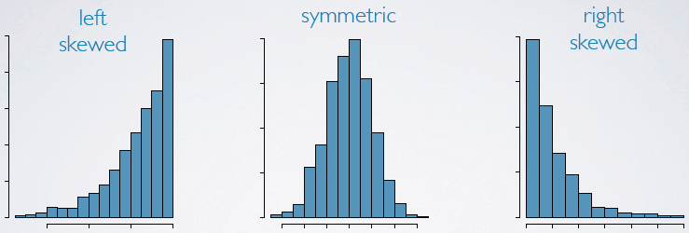
Histogram (contd.)
We can also infer about the symmetry of the data from Histograms
Left skewed is also known as negative skewed and right skewed is also known as positive skewed
http://www.bindichen.co.uk/post/Notes/data-analysis-and-statistical-inference/visualizing-numerical-data.html
Notes:
Now explain the histogram of Per Cap GDP data

Slide 58
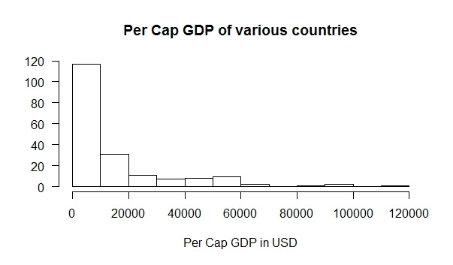
Histogram (contd.)
Lets have a look at the histogram of Per Cap GDP data
Notes:
Data is unimodal
Histogram is Right (or) Positive skewed
Mode is between 0 and 10,000$
Outliers can be seen in the data

Slide 59
Introduction to Probability

Slide 60
Definitions
Probability – The chance or likelihood that a particular uncertain event will occur
Sample Space – Collection of all possible events
Event – An event is a subset of a the sample space
For e.g. let us consider an experiment where a coin is tossed twice
The sample space is the all possible outcomes which in our case is {HH, HT, TH, TT}
We are interested in the case where at least one head occurs
So our event is {HH, HT, TH}

Slide 61
Definitions (contd.)
Complement of an Event – All outcomes that are not part of an event
For e.g. the complement of the event at least one head occurs is no head occurs and is given by the subset {TT}
Complement of event A is denoted by A^{C}
Intersection of events – The probability that events A and B both occur
Intersection of events A and B is denoted by P(A∩B)
Union of events – The probability that event A or B occurs
Union of events A and B is denoted by P(A∪B)
Notes:
Explain P(A∪B) = P(B∪A) and P(A∩B) = P(B∩A)

Slide 62
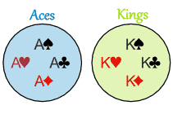
Definitions (contd.)
Mutually exclusive events – Events that can’t happen together
For e.g. When we draw a card from a deck of cards, the event of getting an ace and the event of getting a king are mutually exclusive
https://www.mathsisfun.com/data/probability-events-mutually-exclusive.html

Slide 63
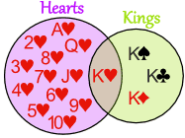
Definitions (contd.)
Mutually exclusive events – Events that can’t happen together
But the event of getting a heart or the event of getting a king are not mutually exclusive since both the events have common elements
https://www.mathsisfun.com/data/probability-events-mutually-exclusive.html

Slide 64
Definitions (contd.)
Collectively exhaustive events – Events that cover the entire sample space
For e.g. When a single coin is tossed, the event A of getting a tail and the event B of getting a head are collectively exhaustive
One of the events must occur

Slide 65

Definitions (contd.)
Let us again consider the event at least one head occurs in a two coin toss
The sample space is {HH, HT, TH, TT}
Total number of possible outcomes in the event is the number of elements in the sample pace which is 4
The subset of at least one head occurs is given by {HH, HT, TH}
So the number of times out event can occur is 3
So the required probability is 3/4
Probability is always between 0 and 1 (0-100%)
Notes:
Another way of thinking about probability is thinking of an experiment. If I were to toss the same coin several thousand times what percentage of the outcome will be heads? Long Run explanation: If out of 10,000 students who have taken the analytics course and 73,000 have passed the exam then you may say that the probability of a student passing the course is 73% or if we toss a coin million times half the times i.e. .5 million times the outcome will be heads
Questions to be asked:
What is the probability of getting a 4 in a roll of a dice?
What is the probability of getting an even number in the roll of a dice?
What is the probability of drawing an Ace in a pack of cards?
What is the probability of drawing a Club in a pack of cards?

Slide 66
Rules of Probability
Rule of subtraction – The complement of any outcome is equal to one minus the outcome
P(A^{C})=1−P(A)
The probability of getting two heads in a two coin toss is ¼
The complement of the event is not getting any heads which is given by ¾
Now probability of getting two heads can be found by subtracting the probability of its complement from 1
1-3/4 = 1/4

Slide 67
Rules of Probability (contd.)
Rule of addition – The probability union of events A and B is equal to the probability that Event A plus the probability that Event B occurs minus the probability of intersection of Events A and B occur
P(A∪B) = P(A) + P(B) - P(A∩B)
Calculate the probability of getting a king or getting an ace while drawing a card from a deck of cards
https://www.mathsisfun.com/data/probability-events-mutually-exclusive.html
Notes:
Explain this using the mutually exclusive diagram

Slide 68
Rules of Probability (contd.)
Two events A and B are said to be independent of each other if the probability of one event occurring is unaffected by the occurrence or non-occurrence of the other event
For e.g. consider two events, a coin toss and a roll of a dice. These are independent of each other as outcome of one does not affect the other
Rule of Multiplication – If two events A and B are independent, then
P(A and B) = P(A).P(B)

Slide 69
Rules of Probability (contd.)
P(A and B) = P(A).P(B)
Let us consider two events a coin toss and roll of a 6 faced dice
The sample space is given by {H1, H2, H3, H4, H5, H6, T1, T2, T3, T4, T5, T6}
Let event A be getting a head in the toss and event B be getting 1 or 2 in the roll of dice
Sub space of A and B is given by {H1, H2}
So P(A and B) is 2/12 = 1/6
P(A) = 1/2 and P(B) = 2/6 = 1/3
P(A).P(B) = 1/2 * 1/3 = 1/6

Slide 70

Conditional Probability
Conditional Probability is the probability of an event A given that another event B has occurred
Probability of A given B has occurred is denoted by P(A|B)
Let us consider the previous example
We want to find the probability of head in the toss and 1 or 2 in the roll of dice
Now we are given additional information that event B has occurred i.e. the outcome of the dice roll is 1 or 2

Slide 71
Conditional Probability (contd.)
Probability of A given B has occurred is denoted by P(A|B)
We need to find P(A∩B)
A∩B = {H1, H2}
P(A∩B) = 2/12 = 1/6
P(A|B) = P(A∩B) / P(B) = 1/2
Let us verify: our new sample space is given by {H1, H2, T1, T2}
Total number of outcomes in the sample space has reduced to 4
Out of this the favourable outcomes are {H1, H2}
P(A|B) = 2/4 = 1/2

Slide 72

Bayes’ Theorem
Bayes’ Theorem helps us to find P(A|B) if we already know P(B|A)
Notes:
Proof:
P(A|B) = P(A∩B) / P(B)
P(A∩B) = P(A|B) * P(B)
P(B∩A) = P(B|A) * P(A)
We know that P(A∩B) = P(A∩B)
Equate both the above equations

Slide 73

Odds
Odds of an event is defined as the probability of that event occurring / probability of that event not occurring
For example, consider a toss of a fair coin
The odds of heads = p(Heads) / (1-p(Heads))
0.5/0.5 = 1 (or) 1:1
In the roll of a fair die, the odds of getting 5 or 6
0.33/0.66 = ½ (or) 1:2
http://www.near-death.com/paranormal/synchronicity/the-odds-of-our-adcs-occurring-by-chance.html

Slide 74
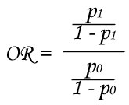
Odds Ratio
Is a ratio of two odds
In the roll of a fair die, the odds of getting 5 or 6
0.33/0.66 = ½ (or) 1:2
Odds of getting 1 = 0.1666/0.83333 = 1/5
Odds ratio = (1/2) / (1/5) = 2.5
Odds of getting 5 or 6 is 2.5 times greater than the odds of getting 1
http://www.near-death.com/paranormal/synchronicity/the-odds-of-our-adcs-occurring-by-chance.html

Slide 75
Probability Distributions

Slide 76
Binomial Distributions
Consider an experiment where one coin is tossed 2 times
Let Y denote the number of heads
We know that:
P(Y=0) = ¼
P(Y=1) = ½
P(Y=2) = ¼

Slide 77
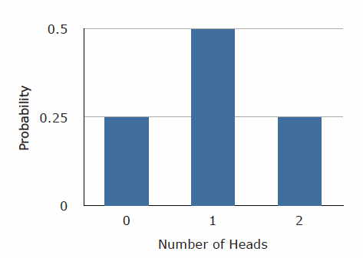
Binomial Distributions (contd.)
Let us plot the probabilities
This is called a Binomial Distribution
http://onlinestatbook.com/2/probability/binomial.html
Notes:
This is called Binomial (2,1/2) meaning the number of events is 2 and the probability of each favourable event is 1/2

Slide 78
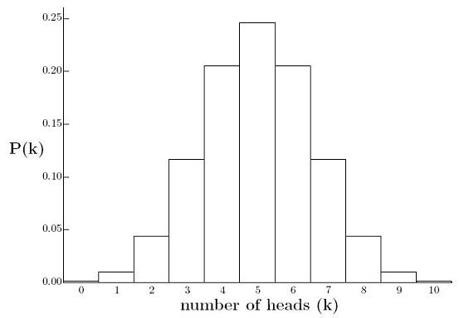
Binomial Distributions (contd.)
Let us increase the number of tosses to 10
http://www.mathamazement.com/Lessons/Everyday-Math/05_Miscellaneous/05_05_Advanced-Math-Topics/normal-distribution.html

Slide 79
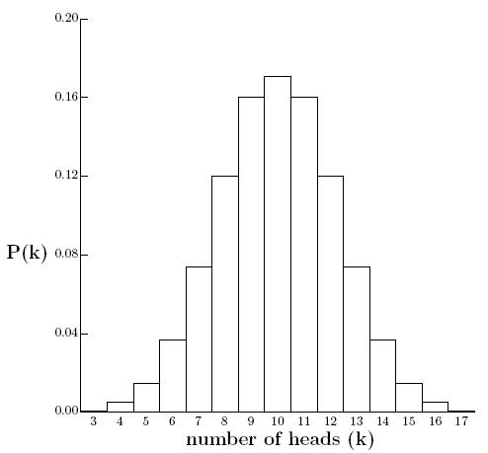
Binomial Distributions (contd.)
Let us repeat the experiment with 20 tosses
http://www.mathamazement.com/Lessons/Everyday-Math/05_Miscellaneous/05_05_Advanced-Math-Topics/normal-distribution.html
Notes:
This is called Binomial (2,1/2) meaning the number of events is 2 and the probability of each favourable event is 1/2

Slide 80
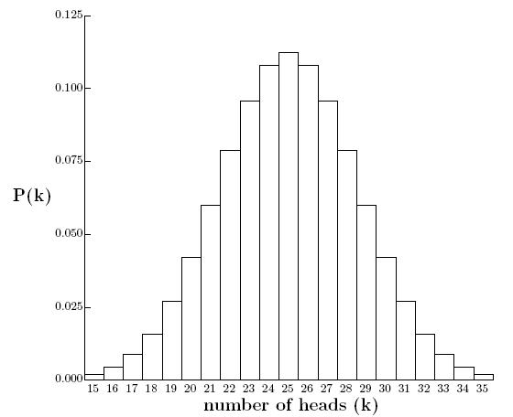
Binomial Distributions (contd.)
50 tosses
http://www.mathamazement.com/Lessons/Everyday-Math/05_Miscellaneous/05_05_Advanced-Math-Topics/normal-distribution.html

Slide 81
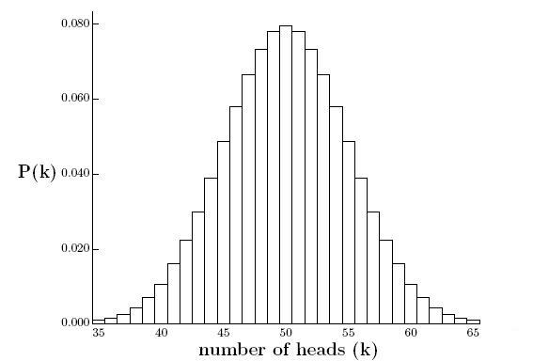
Binomial Distributions (contd.)
100 tosses
http://www.mathamazement.com/Lessons/Everyday-Math/05_Miscellaneous/05_05_Advanced-Math-Topics/normal-distribution.html
Notes:
Notice that a bell shaped pattern emerging

Slide 82
Continuous Distributions
So far we have seen probability distributions of discrete variables
Number of heads in our previous experiments can only be whole numbers
Let us think of some continuous variables instead of a discrete variable like number of heads in a series of coin tosses
Let us consider the average speed of vehicles at a point in a highway
Let us graph the probability of speed of a random vehicle

Slide 83
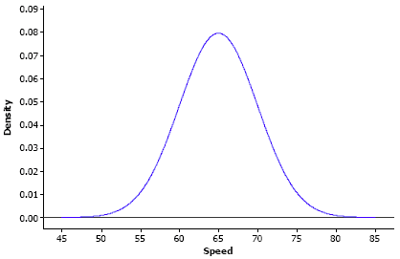
Continuous Distributions (contd.)
This graph is called probability density function
http://sites.stat.psu.edu/~ajw13/stat200/mos/05_probdistr/05_probdistr_print.html
Notes:
In the graph, most vehicles are going at 65 km/h and that is why there is a peak in the probability at 65. Very few vehicles go less than 50 km/h and more than 80 km/h

Slide 84
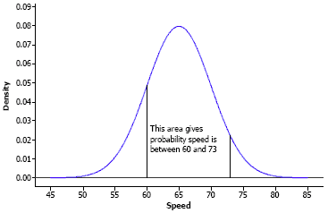
Continuous Distributions (contd.)
Unlike discrete distribution, we can’t directly find the probability of a point
In continuous distributions probability can be found only for intervals
Probability for an interval = Area under the curve in that interval
http://sites.stat.psu.edu/~ajw13/stat200/mos/05_probdistr/05_probdistr_print.html
Notes:
Ask the question what will be the total area under the curve. It should be 1 as probability can’t be greater than

Slide 85
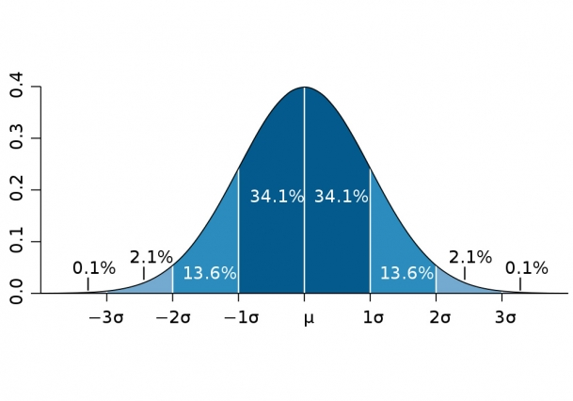
Normal Distribution
Popularly known as bell-shaped curve
Normal distribution has a mean of μ and a standard distribution of σ
http://news.mit.edu/2012/explained-sigma-0209

Slide 86
Normal Distribution (contd.)
Features of a Normal Distribution:
Mean=Median=Mode
Symmetric about the centre
Defined by two parameters μ and σ
Many natural occurring phenomenon follow normal distribution
Height of a large population
Blood pressure
Notes:
Mean = Median means 50% of the population lies below the mean and 50% of the population lies above the mean
Height is one simple example of something that follows a normal distribution pattern: Most people are of average height, the numbers of people that are taller and shorter than average are fairly equal and a very small (and still roughly equivalent) number of people are either extremely tall or extremely short.
Your blood pressure varies with time. It is also normally distributed

Slide 87
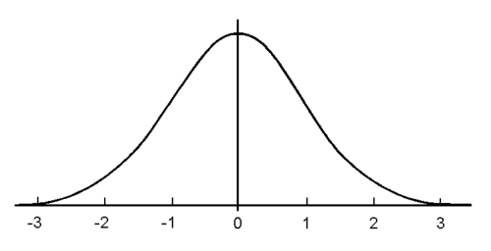
Standard Normal Distribution
Standard Normal Distribution is a special case of Normal Distribution where mean, μ = 0 and standard deviation, σ = 1

